Slide 1

Security+
Exam SY0-601
Chapter 26
Tools to Assess Organizational Security
Notes:
Gain Attention

Slide 2
Chapter 26 (Domain 4.1) Learning Objectives
Use the appropriate tool to assess organization security.
Network reconnaissance and discovery
Tracert/traceroute
Nslookup/dig
Nmap
Ping/pathping
Hping
Netstat
Netcat
IP scanners
Arp
Route
Curl
theHarvester
Sn1per
Scanless
Dnsenum
Nessus
Cuckoo
File manipulation
head
tail
cat
grep
chmod
logger
Shell and script environments
SSH
PowerShell
Python
OpenSSL
Packet capture and replay
TCPreplay
TCPDump
Wireshark
Forensics
dd
Memdump
WinHex
FTK imager
Autopsy
Exploitation frameworks
Password crackers
Data sanitization

Slide 3
tracert/traceroute
The tracert command is a Windows command for tracing the route that packets take over the network.
The tracert command provides a list of the hosts, switches, and routers in the order in which a packet passes through them, providing a trace of the network route from source to target.
As tracert uses Internet Control Message Protocol (ICMP), if ICMP is blocked, tracert will fail to provide information.
On Linux and macOS systems, the command with similar functionality is traceroute.

Slide 4
nslookup/dig
To examine a DNS query for a specific address, you can use the nslookup command.
The command dig, which stands for Domain Information Groper, works on Linux systems.
One difference is that dig is designed to return answers in a format that is easy to parse and include in scripts, which is a common trait of Linux command-line utilities.

Slide 5
ipconfig/ifconfig
Both ipconfig (for Windows) and ifconfig (for Linux) are command-line tools to manipulate the network interfaces on a system.
They have the ability to list the interfaces and connection parameters, alter parameters, and release/renew connections.
The ip command in Linux is used to show and manipulate routing, devices, policy routing, and tunnels.
The ipconfig command is an important command for troubleshooting because it displays current TCP/IP configurations on a local system.
This is an important troubleshooting tool because when you can’t connect to something, it is the first place to start exploring network connections, as it gives you all of your settings.

Slide 6
nmap
Nmap is a is free, open-source port scanning tool developed by Gordon Lyon and has been the standard network mapping utility for Windows and Linux since 1999.
The nmap command is the command to launch and run the nmap utility.
Nmap is used to discover what systems are on a network and the open ports and services on those systems.
This tool has many other additional functions, such as OS fingerprinting, finding rogue devices, and discovering services and even application versions.
It operates via the command line, so it’s very scriptable. It also has a GUI interface called Zenmap.

Slide 7
ping/pathping
The ping command sends echo requests to a designated machine to determine if communication is possible.
The syntax is ping [options] targetname/address.
The options include items such as name resolution, how many pings, data size, TTL counts, and more.
Pathping is a TCP/IP-based utility that provides additional data beyond that of a ping command.
Combination of ping and tracert.

Slide 8
hping
hping is a TCP/IP packet creation tool that allows a user to craft raw IP, TCP, UDP, and ICMP packets from scratch.
This tool provides a means of performing a wide range of network operations; anything that you can do with those protocols can be crafted into a packet.
This includes port scanning, crafting ICMP packets, host discovery, and more.
The current version is hping3, and it is available on most operating systems, including Windows and Linux.

Slide 9
hping
Like all Linux commands, hping can be programmed in Bash scripts to achieve greater functionality.
Outputs can also be piped to other commands. Hping also works with an embedded Tcl scripting functionality, which further extends its usefulness for system administrators.
Between the range of options and the native scripting capability, hping offers a wide range of functions, including creating password-protected backdoors that are piped to other services.
The power comes from the programmability, the options, and the creative work of system administrators.

Slide 10
netstat
The netstat command is used to monitor network connections to and from a system.
The netstat command is available on Windows and Linux, but availability of certain netstat command switches and other netstat command syntax may differ from operating system to operating system.
The netstat command is useful for viewing all listening ports on a computer and determining which connections are active.

Slide 11
netcat
Netcat is the network utility designed for Linux environments.
It has been ported to Windows but is not regularly used in Windows environments.
The actual command to invoke netcat is: nc –options –address.
It is designed for scripts and automation.
Netcat has a wide range of functions.
It acts as a connection to the network and can act as a transmitter or a receiver, and with redirection it can turn virtually any running process into a server.
It can listen on a port and pipe the input it receives to the process identified.

Slide 12
IP Scanners
Scan IP networks and can report on the status of IP addresses.
There are a wide range of free and commercial scanning tools, and most come with significantly greater functionality than just reporting on address usage.
If all you want are addresses, there are a variety of simple command-line network discovery tools that can provide those answers.
Another solution is Nessus, a commercial offering covered later in the chapter.

Slide 13
arp
The arp command is designed to interface with the operating system’s Address Resolution Protocol (ARP) caches on a system.
In moving packets between machines, a device sometimes needs to know where to send a packet using the MAC or layer 2 address.
ARP handles this problem through four basic message types:
ARP request “Who has this IP address?”
ARP reply “I have that IP address; my MAC address is…”
Reverse ARP (RARP) request “Who has this MAC address?”
RARP reply “I have that MAC address; my IP address is…”

Slide 14
route
The route command works in Linux and Windows systems to provide information on current routing parameters and to manipulate these parameters.
In addition to listing the current routing table, it has the ability to modify the table.

Slide 15
curl
Curl is a tool designed to transfer data to or from a server, without user interaction. It support a long list of protocols (DICT, FILE, FTP, FTPS, Gopher, HTTP, HTTPS, IMAP, IMAPS, LDAP, LDAPS, MQTT, POP3, POP3S, RTMP, RTMPS, RTSP, SCP, SFTP, SMB, SMBS, SMTP, SMTPS, Telnet, and TFTP).
Originally designed to interact with URLs, curl has expanded into a jack-of-all-trades supporting numerous protocols.
It works on both Linux and Windows systems, although the command options are slightly different.
curl https://www.example.com

Slide 16
theHarvester
theHarvester is a Python-based program designed to assist penetration testers in the gathering of information during the reconnaissance portion of a penetration test.
This is a useful tool for exploring what is publicly available about your organization on the Web, and it can provide information on employees, e-mails, and subdomains using different public sources such as search engines, PGP key servers, and Shodan databases.
Designed for Linux and included as part of Kali and other penetration testing distributions

Slide 17
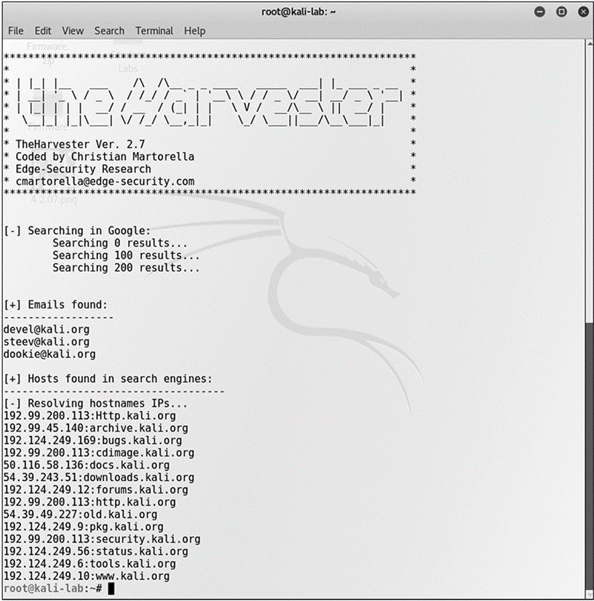
theHarvester

Slide 18
sn1per
Sn1per is a Linux-based tool used by penetration testers.
Sn1per is an automated scanner designed to collect a large amount of information while scanning for vulnerabilities.
It runs a series of automated scripts to enumerate servers, open ports, and vulnerabilities, and it’s designed to integrate with the penetration testing tool Metasploit.
Sn1per goes further than just scanning; it can also brute force open ports, brute force subdomains and DNS systems, scan web applications for common vulnerabilities, and run targeted nmap scripts against open ports as well as targeted Metasploit scans and exploit modules.

Slide 19
scanless
Scanless is a command-line utility to interface with websites that can perform port scans as part of a penetration test.
When you use this tool, the source IP address for the scan is the website, not your testing machine.
Written in Python, with a simple interface,
scanless anonymizes your port scans.

Slide 20
dnsenum
dnsenum is a Perl script designed to enumerate DNS information.
dnsenum will enumerate DNS entries, including subdomains, MX records, and IP addresses.
It can interface with Whois, a public record that identifies domain owners, to gather additional information.
dnsenum works on Linux distros that support Perl.

Slide 21
Nessus
Nessus is one of the leading vulnerability scanners in the marketplace.
It comes in a free version, with limited IP address capability, and fully functional commercial versions.
Nessus is designed to perform a wide range of testing on a system, including the use of user credentials, patch level testing, common misconfigurations, password attacks, and more.
Designed as a full suite of vulnerability and configuration testing tools, Nessus is commonly used to audit systems for compliance to various security standards such as PCI DSS, SOX, and other compliance schemes.
Nessus free version was the original source of the OpenVAS fork, which is a popular free vulnerability scanner.

Slide 22
Cuckoo
Cuckoo is a sandbox used for malware analysis.
Cuckoo is designed to allow a means of testing a suspicious file and determining what it does.
It is open source, free software that can run on Linux and Windows.
Cuckoo is a common security tool used to investigate suspicious files, as it can provide reports on system calls, API calls, network analysis, and memory analysis.

Slide 23
File Manipulation
In computer systems, most information can be represented as a file.
Files are files, as are directories and even entire storage systems.
The concept of a file is the basic interface to information. Because of this, file manipulation tools have the ability to manage a lot of tasks.
As many operations are scripted, the ability to manipulate a file, returning specific elements or records, has great utility.
This next section looks at a bunch of tools used to manipulate files in Linux systems.

Slide 24
File Manipulation
head
Head is a utility designed to return the first lines of a file.
tail
Tail is a utility designed to return the last lines of a file.
cat
Cat is a Linux command, short for concatenate, that can be used to create and manipulate files. It can display the contents of a file, handle multiple files, and can be used to input data from stdin, which is a stream of input, to a file if the file does not exist.

Slide 25
File Manipulation
grep
Grep is a Linux utility that can perform pattern-matching searches on file contents. The name grep comes from “Globally search for Regular Expression and Print the matching lines.”
chmod
chmod is the Linux command used to change access permissions of a file.
logger
The Linux command logger is how you can add log file information to /var/log/syslog.

Slide 26
Shell and Script Environments
One of the more powerful aspects of the Linux environment is the ability to create shell scripts.
By combining a series of functions, and through the use of redirecting inputs and outputs, one can do significant data manipulation.

Slide 27
SSH
SSH (Secure Shell) is a cryptographically secured means of communicating and managing a network over an unsecured connection.
It was originally designed as a replacement for the plaintext protocols of Telnet and other tools.
When remotely accessing a system, it is important not to use a plaintext communication channel, as that would expose information such as passwords and other sensitive items to interception.

Slide 28
PowerShell
PowerShell is a Microsoft Windows-based task automation and configuration management framework, consisting of a command-line shell and scripting language.
PowerShell is built on top of the .NET Common Language Runtime (CLR) and accepts and returns .NET objects.
The commands used in PowerShell are called cmdlets, and they can be combined to process complex tasks.
PowerShell can be run from a PowerShell Console prompt, or through the Windows PowerShell Integrated Scripting Environment (ISE), which is a host application for Windows PowerShell.

Slide 29
Python
Python is a computer language commonly used for scripting and data analysis tasks facing system administrators and security personnel.
Python is a full-fledged computer language.
It supports objects, functional programming, and garbage collection, and most importantly has a very large range of libraries that can be used to bring functionality to a program.
The downside is that it is interpreted, so speed is not a strong attribute.
However, usability is high, and coupled with the library support, Python is a must-learn language for most security professionals.
Python is a general-purpose computer programming language that uses the file extension .py.

Slide 30
OpenSSL
OpenSSL is a general-purpose cryptography library that offers a wide range of cryptographic functions on Windows and Linux systems.
Designed to be a full-featured toolkit for the Transport Layer Security (TLS) and Secure Sockets Layer (SSL) protocols, it provides so much more for real-world daily challenges.

Slide 31
OpenSSL
OpenSSL can perform the following tasks in either scripts or programs, offering access to cryptographic functions without having to develop the code:
Work with RSA and ECDSA keys
Create certificate signing requests (CSRs)
Verify CSRs
Create certificates
Generate self-signed certificates
Convert between encoding formats (PEM, DER) and container formats (PKCS12, PKCS7)
Check certificate revocation status
And more…

Slide 32
Packet Capture and Replay
Computers communicate and exchange data via network connections by way of packets.
Software tools that enable the capturing, editing, and replaying of the packet streams can be very useful for a security professional.
Whether you’re testing a system or diagnosing a problem, having the ability to observe exactly what is flowing between machines and being able to edit the flows is of great utility.
The tools in this section provide this capability.
They can operate either on live network traffic or recorded traffic in the form of packet capture (PCAP) files.

Slide 33
Tcpreplay
Tcpreplay is the name for both a tool and a suite of tools.
As a suite, tcpreplay is a group of free, open-source utilities for editing and replaying previously captured network traffic.
As a tool, it specifically replays a PCAP file on a network.
Originally designed as an incident response tool, tcpreplay has utility in a wide range of circumstances where network packets are used.
It can be used to test all manner of security systems through the use of crafted PCAP files to trip certain controls. It is also used to test online services such as web servers.

Slide 34
Tcpdump
The tcpdump utility is designed to analyze network packets either from a network connection or a recorded file.
You also can use tcpdump to create files of packet captures, called PCAP files, and perform filtering between input and output, making it a valuable tool to lessen data loads on other tools.
For example, if you have a complete packet capture file that has hundreds of millions of records, but you are only interested in one server’s connections, you can make a copy of the PCAP file containing only the packets associated with the server of interest.
This file will be smaller and easier to analyze with other tools, such as Wireshark.

Slide 35
Wireshark
Wireshark is the gold standard for graphical analysis of network protocols.
With dissectors that allow the analysis of virtually any network protocol, this tool can allow you to examine individual packets, monitor conversations, carve out files, and more.
When it comes to examining packets, Wireshark is the tool.
When it comes to using this functionality in a scripting environment, TShark provides the same processing in a scriptable form, producing a wide range of outputs, depending on the options set.
Wireshark has the ability to capture live traffic, or it can use recorded packets from other sources.

Slide 36
Forensics
Digital forensics is the use of specific methods to determine who did what on a system at a specific time, or some variant of this question.
Computers have a wide range of artifacts that can be analyzed to make these determinations.
There are tools to collect these artifacts, and tools used to analyze the data collected.
In this section, we examine some of the primary tools used in these efforts.
Digital forensic processes and procedures are covered in detail in Chapter 30, “Digital Forensics.”
This is just an examination of some of the tools used.

Slide 37
dd
Data dump (dd) is a Linux command-line utility used to convert and copy files.
On Linux systems, virtually everything is represented in storage as a file, and dd can read and/or write from/to these files, provided that function is implemented in the respective drivers.
As a result, dd can be used for tasks such as backing up the boot sector of a hard drive, obtaining a fixed amount of random data, or copying (backing up) entire disks.
The dd program can also perform conversions on the data as it is copied, including byte order swapping and conversion to and from the ASCII and EBCDIC text encodings.
dd has the ability to copy everything, back up/restore a partition, and create/restore an image of an entire disk.

Slide 38
dd
When doing a forensics data capture, rather than taking a backup of the hard disk, you should create an image file of the hard disk and save it on another storage device.
There are many advantages to backing up your data to a disk image, one being the ease of use.
Image files contain all the information on the associated source, including unused and previously used space.

Slide 39
memdump
Linux has a utility program called memory dumper, or memdump.
This program dumps system memory to the standard output stream, skipping over any holes in memory maps.
By default, the program dumps the contents of physical memory (/dev/mem).
The output from memdump is in the form of a raw dump.
Because running memdump uses memory, it is important to send the output to a location that is off the host machine being copied, using a tool such as netcat.

Slide 40
WinHex
WinHex is a hexadecimal file editor.
This tool is very useful in forensically investigating files, and it provides a whole host of forensic functions such as the ability to read almost any file, display contents of the file, convert between character sets and encoding, perform hash verification functions, and compare files.
As a native file reader/hex editor, it can examine specific application files without invoking the application and changing the data.
WinHex is a commercial program that is part of the X-Ways forensic suite, which is a comprehensive set of digital forensic tools.

Slide 41
FTK Imager
FTK Imager is the company AccessData’s answer to dd.
FTK Imager is a commercial program, free for use, and is designed to capture an image of a hard drive (or other device) in a forensic fashion.
Forensic duplications are bit-by-bit copies, supported by hashes to demonstrate that the copy and the original are exact duplicates in all ways.
As with all forensically sound collection tools, FTK Imager retains the file system metadata (and the file path) and creates a log of the files copied.
This process does not change file access attributes. FTK Imager is part of the larger, and commercial, FTK suite of forensic tools.

Slide 42
Autopsy
Autopsy is the open-source answer for digital forensic tool suites.
This suite, developed by Brian Carrier, has evolved over the past couple of decades into a community-supported open-source project that can perform virtually all digital forensic functions.
It runs on Windows and offers a comprehensive set of tools that can enable network-based collaboration and automated, intuitive workflows.
It has tools to support hard drives, removable devices, and smartphones.
It supports MD5 hash creation and lookup, deleted file carving, EXIF data extraction from JPEG images, indexed keyword searches, extension mismatch detections, e-mail message extractions, and artifact extractions from web browsers.

Slide 43
Exploitation Frameworks
Exploitation frameworks are toolsets designed to assist hackers in the tasks associated with exploiting vulnerabilities in a system.
These frameworks are important because the exploitation path typically involves multiple steps, all done in precise order on a system to gain meaningful effect.
The most commonly used framework is Metasploit, a set of “tools” designed to assist a penetration tester in carrying out the steps needed to exploit a vulnerability on a system.
These frameworks can be used by security personnel as well, specifically to test the exploitability of a system based on existing vulnerabilities and employed security controls.

Slide 44
Password Crackers
Password crackers are used by hackers to find weak passwords.
Why would a system administrator use one? Same reason.
Running your system’s password lists through a password cracker provides two things: an early warning of a crackable password, and peace of mind that your passwords are safe when you can’t crack any in a reasonable period of time.
Password crackers work using dictionary lists and brute force.
On a modern Core i9 machine with a GPU, ten-character passwords will fall in roughly a week of work.
With the use of multiple GPUs through a cloud vendor, this can fall to hours.

Slide 45
Data Sanitization
Data sanitization tools are tools used to destroy, purge, or otherwise identify for destruction specific types of data on systems.
Before a system can be retired and disposed of, you need to sanitize the data needs.
There are several approaches, the first being the whole disk approach.
You can use a data sanitization tool to erase or wipe the entire storage of the system, making the data no longer recoverable.

Slide 46
Data Sanitization
One method of doing this is to use self-encrypting disks, and the destruction of the key leaves the disk unrecoverable.
A second, more targeted approach is to identify the sensitive data and deal with it specifically.
Tools such as Identity Finder excel at this aspect of data sanitization.
As with all tools, it is not the tool that provides the true value but rather the processes and procedures that ensure the work is done and done correctly when required.

Slide 47
Data Sanitization
Types of data sanitization:
Delete/Reformat
Wipe
Overwrite
Erasure
Degaussing
Purging
Physical destruction
Electronic shredding
Solid State shredding
Pulping (for paper-based data)

